Slide 1
Remote Hearing Requests in Circuit Court
The Honorable Tanya Felton

Slide 2
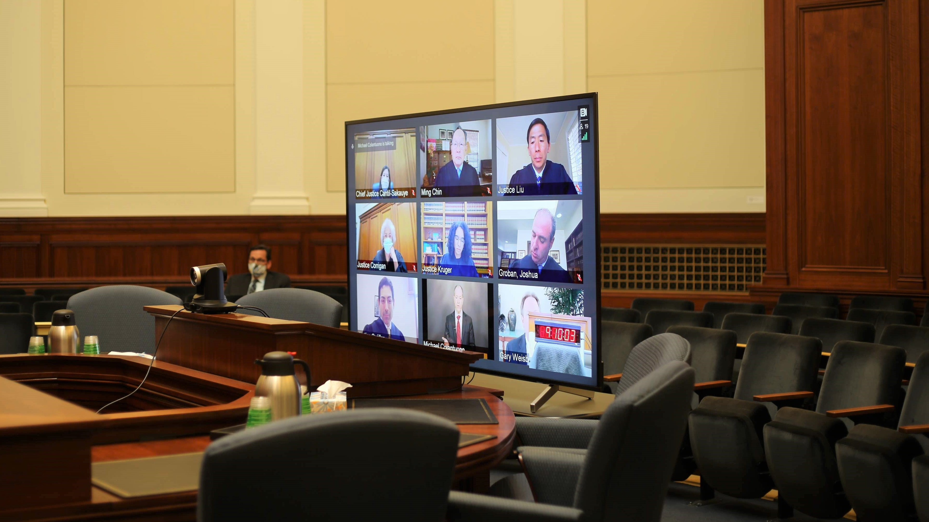

Slide 3
2024 Survey Results – Civil Hearings
Status Hearings
First or initial appearances
Non-Evidentiary hearings
Ex parte emergency hearings
Motions

Slide 4
2024 Survey Results – Criminal Hearings
Initial appearances at which bail will be set
Waiver of Preliminary Hearing
Arraignments
Non-evidentiary hearings

Slide 5
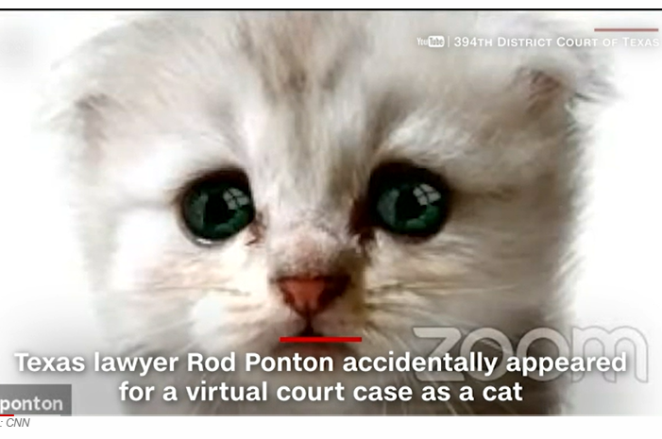
Drawbacks – 2024 Survey
Connectivity issues
Audio issues
Diminished human element

Slide 6

Drawbacks Cont’d.
No centralized standards
Many requests are submitted ex parte
Requests are not in accordance with Rule 1:27

Slide 7
Va. Supreme Court Rule 1:27
Rule 1:27. Testimony by Audiovisual Means in Circuit Court Civil Cases. (a) The court may permit a party in any civil trial or proceeding to present live testimony by means of audiovisual technology upon such conditions as the court may impose. Unless the court in its discretion allows a motion on shorter notice, such motion must be made, whether orally or in writing, at least 15 days in advance of the trial or hearing. Any party opposing a written motion must file any objections in writing 5 days after service of such motion, unless a different schedule is set by the court.

Slide 8
Presumptive cases for allowing remote testimony
(d)….The court should enter an order permitting live testimony under this Rule as follows:
(1) Consent of All Parties; or
(2) Distant and Other Specific Witnesses. If:
  (i) a lay witness is at a greater distance than 100 miles from the place of trial or hearing, or is out of the Commonwealth, unless it appears that the absence of the witness was procured by the party offering the testimony, or if
  (ii) the witness is a superintendent of a hospital for the insane more than 30 miles from the place of trial, or is a physician, surgeon, dentist, chiropractor, registered nurse, physician’s assistant or nurse practitioner who, in the regular course of his or her profession, treated or examined any party to the proceeding, or is in any public office or service the duties of which prevent his attending court; provided, however, that if the witness is subject to the jurisdiction of the court, the court may, upon a showing of good cause or sua sponte, order the witness to attend and to testify ore tenus

Slide 9
Additional Statutes
Criminal Cases – 19.2-3.1
Va. Code §20-88.59 (UIFSA)

Slide 10
Ideal Remote Hearing Cases
Non-evidentiary hearings that will take less than 30 minutes
Pretrial Conferences
Hearings with legal argument only
Emergency motions to continue
Arraignments
Bond hearings
Motions to compel –less than 30 minutes
Status hearings
All remote hearings are subject to each individual judge’s discretion.

Slide 11
Questions?

Slide 12
Thank You!

